Slide 1


Serverless Holiday Hackathon 2023

Slide 2



Our plans for today
About Serverless Guru
Judges and Podium Finishers
The Winner!
Q & A

Slide 3
About Serverless Guru
Your Guide to Serverless Adopt. Migrate. Build.

Slide 4
Our Company
We love to take on challenges, face the unknown, and be on the forefront of serverless innovation.
Helping companies and people realize their full potential gives us energy.
Speak to a Guru today!

Slide 5
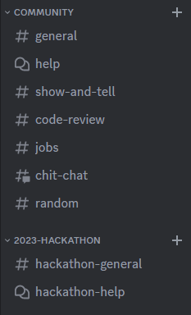

Join our discord Server!

Slide 6
The Judges & Podium Finishers

Slide 7
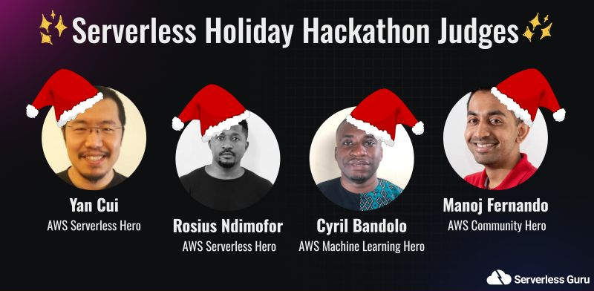
The Judges

Slide 8

3rd Place
Muaaz Bayat
Join our discord Server!
Notes:
Robodolph - Seasonal job listings and access via whatsapp

Slide 9
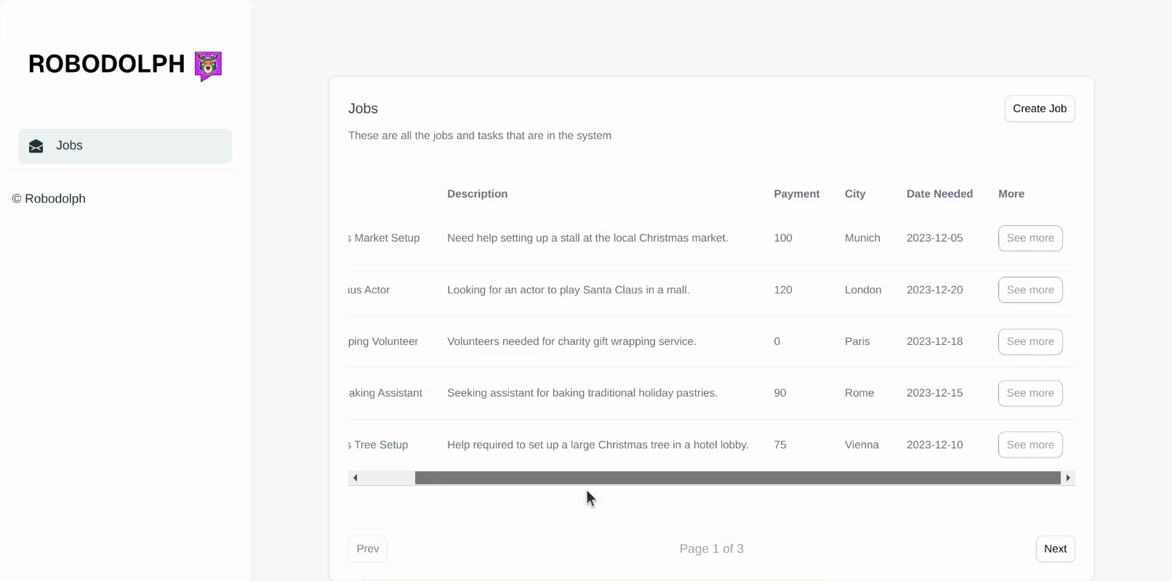
3rd Place

Slide 10
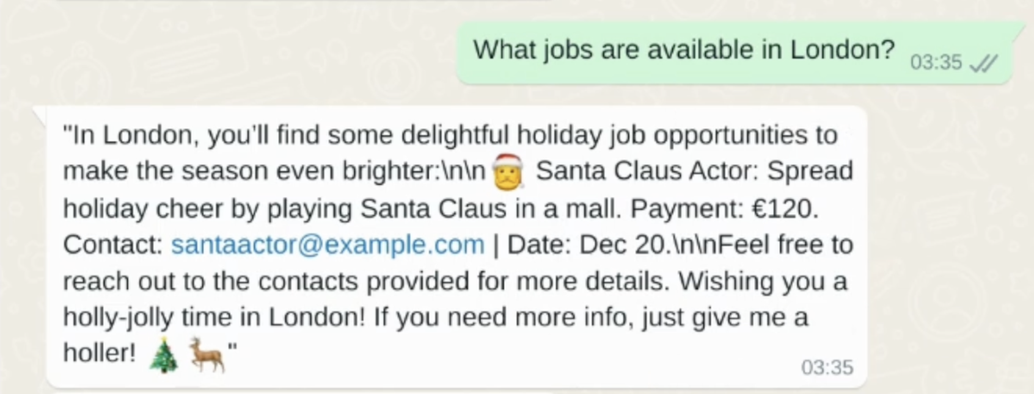
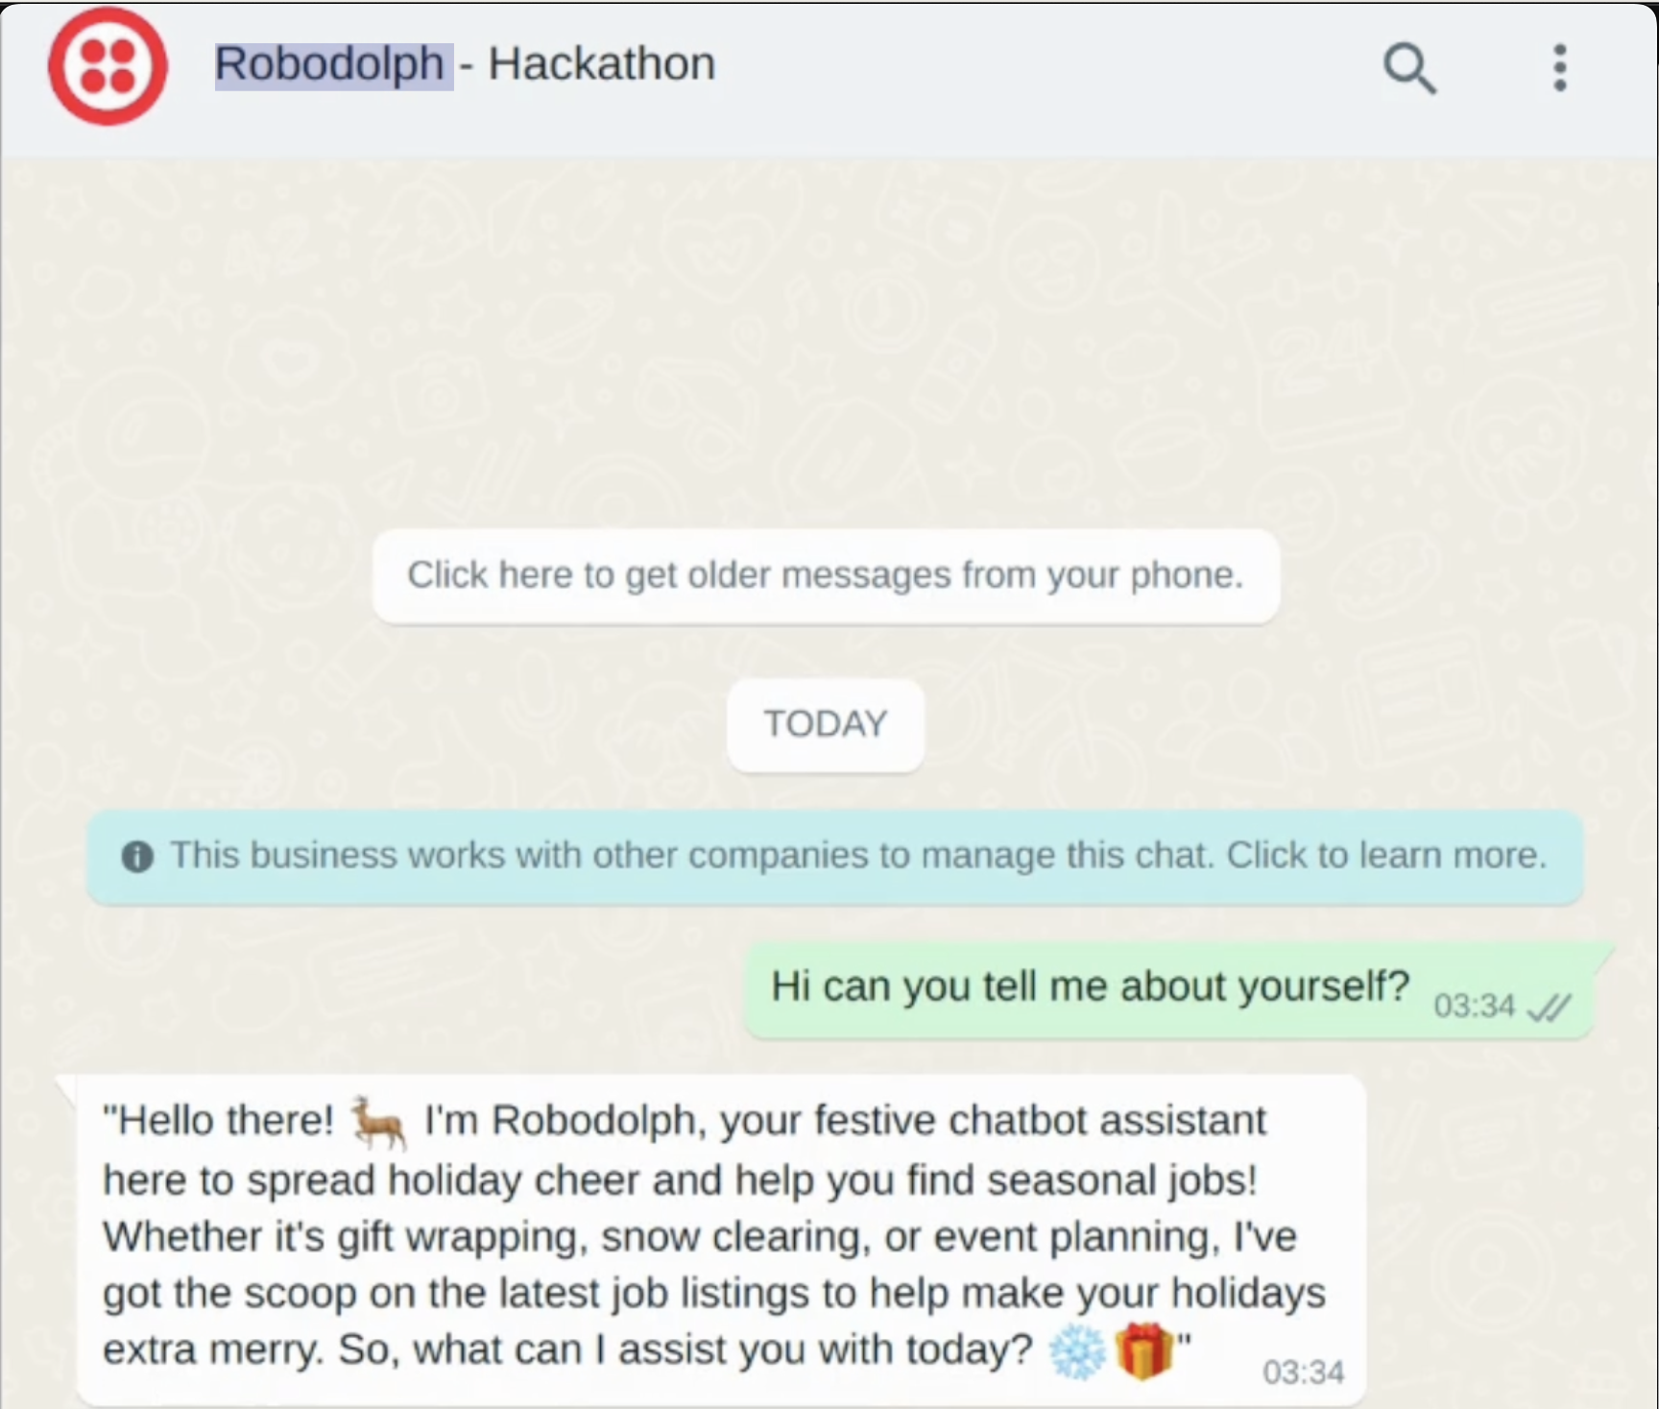
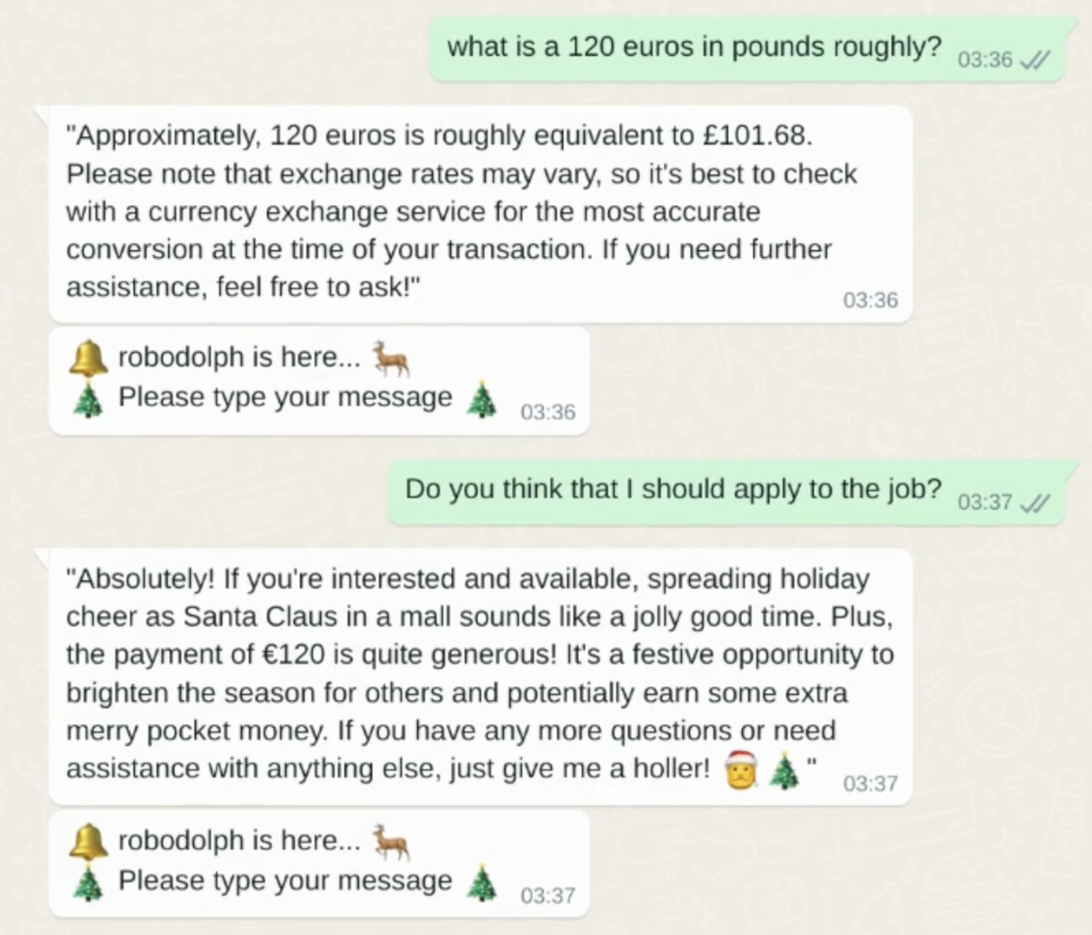
3rd Place

Slide 11
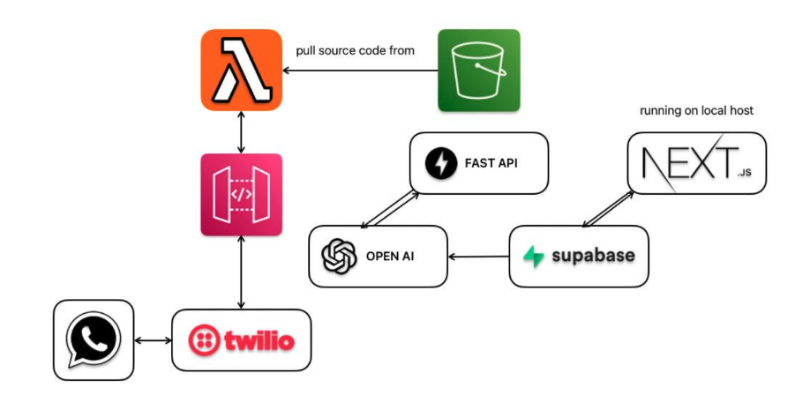
3rd Place
Notes:
Open AI assistant Supabase used for thread management

Slide 12

2nd Place
Riya Bhavsar & Jay Bhavsar
Join our discord Server!

Slide 13
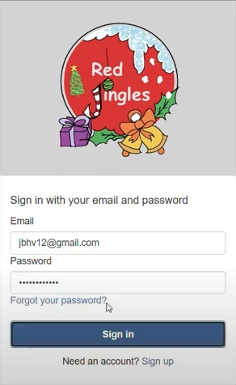
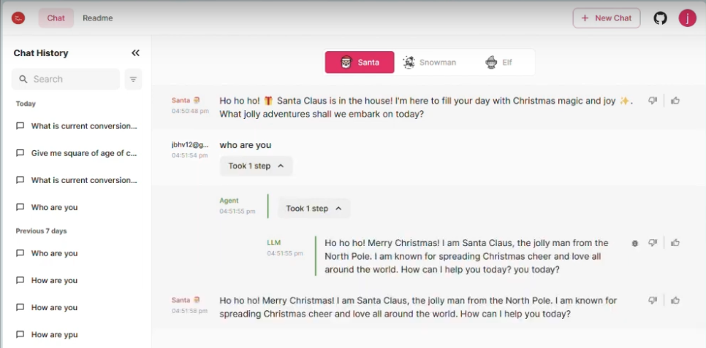
2nd Place

Slide 14
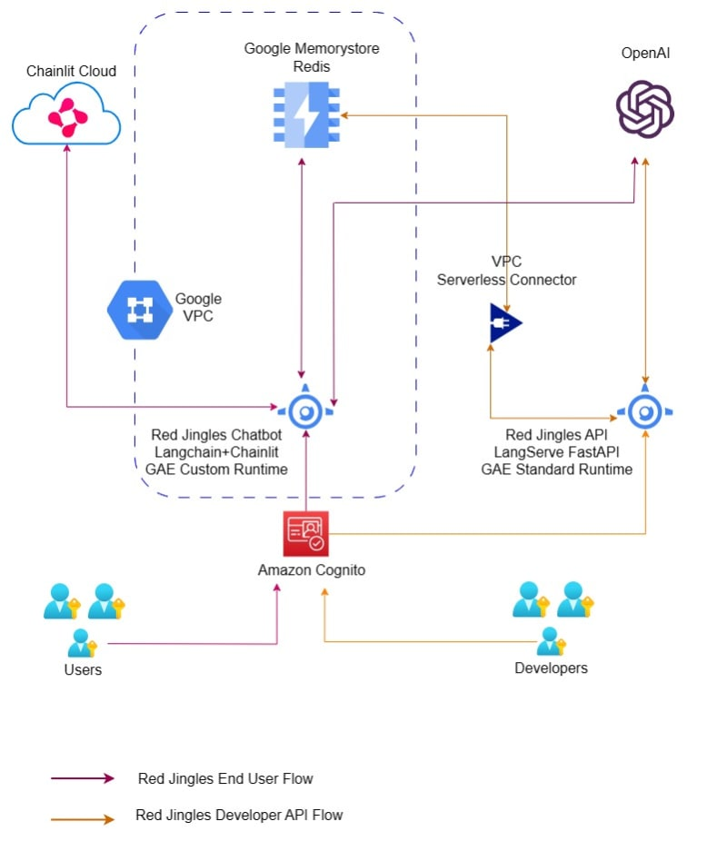
2nd Place

Slide 15

The Winner!
Allen Helton

Slide 16
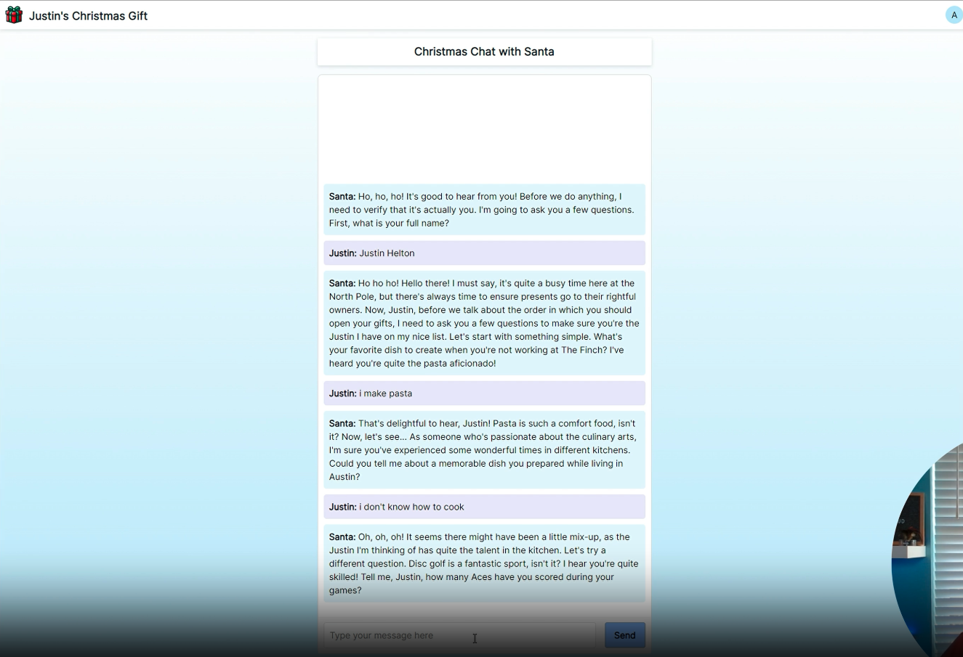
The Winner!

Slide 17
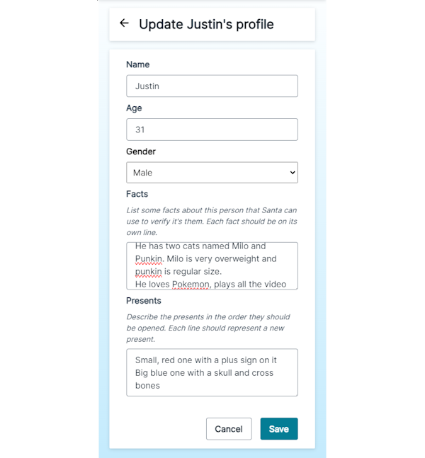
The Winner!

Slide 18
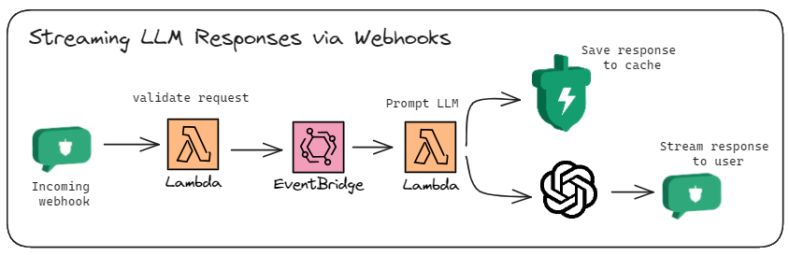
The Winner!

Slide 19
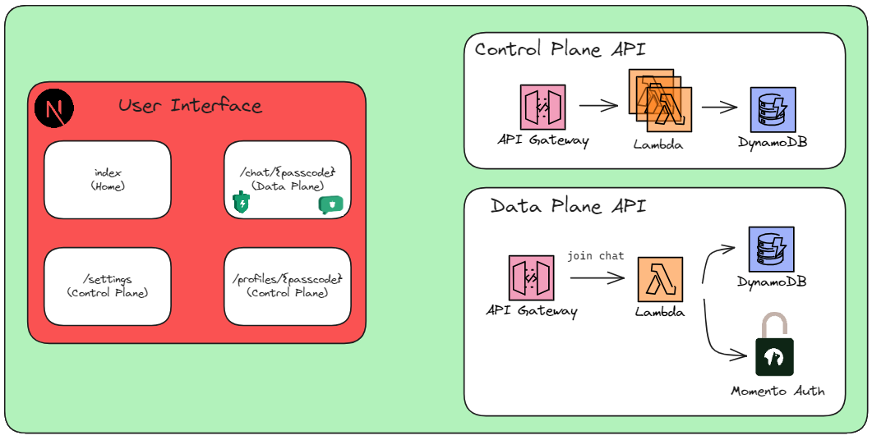
The Winner!

Slide 20
Questions & Answers
We are here to help!
Raise any questions or concerns you might have

Slide 21
Thank you!
Join our discord Server!

